Slide 1
Retail Sales Data Analysis
A comprehensive overview of customer behavior and sales performance
Presented by: Rupsa Chaudhuri

Slide 2



Data Overview
Objective:
Understand customer behavior.
Identify transaction trends.
Evaluate campaign effectiveness.
Dataset Overview: The customer dataset provides valuable insights into transaction data and customer response to a campaign, offering a unique opportunity to explore customer behavior and campaign effectiveness.
Challenges: The challenges include data cleaning, handling missing values and transforming data for a meaningful analysis.
Methodology: Data cleaning and preparation, customer segmentation, time series analysis, customer lifetime value(CLV) analysis, and hypothesis testing were employed to draw significant insights. Exploratory data analysis using SQL.

Slide 3

Detailed Python Data Analysis

Slide 4
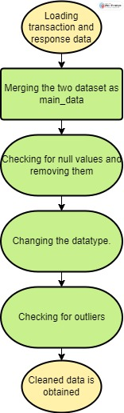
Understanding the Data
Process Overview:
Merging Datasets: Combining transaction and response data to gain a comprehensive view of customer behavior.
Handling Missing Values: Ensuring data integrity by addressing missing values and transforming data for meaningful analysis.
Creating recency , frequency & monetary dataset(rfm) for analysis which includes:
customer_id: Identifier for customers.
recency: Date of the most recent transaction.
frequency: Number of transactions.
monetary: Total amount spent.

Slide 5
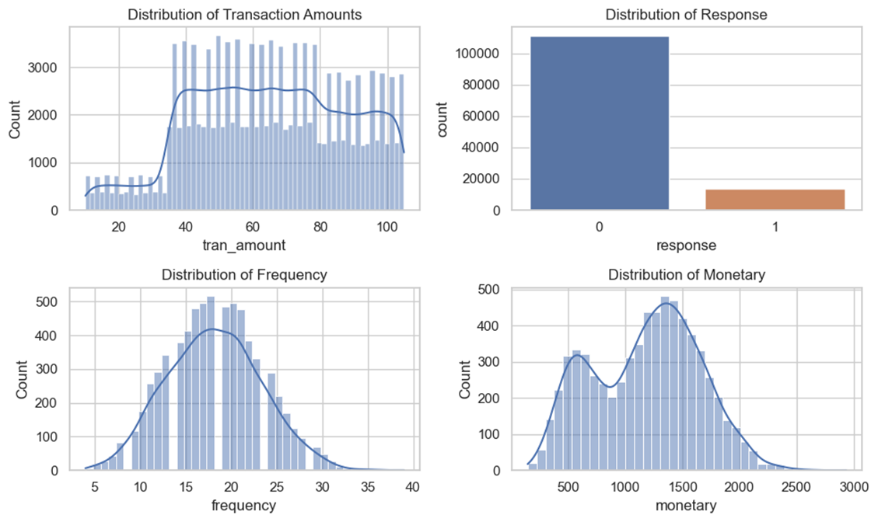
Descriptive Statistics and Visualization
Transaction amount typically range from 40 to 100, indicating common purchase sizes.
High non-response rates suggest most customers are not interested in the campaign.
Most customers have around 20 transactions, indicating regular engagement.
Two distinct spending peaks suggest the presence of high spenders and low spenders.
Transactions typically range from 40 to 100 units, with most customers having about 20 transactions. Low campaign response suggests disinterest, and distinct spending peaks indicate high and low spender segments.

Slide 6
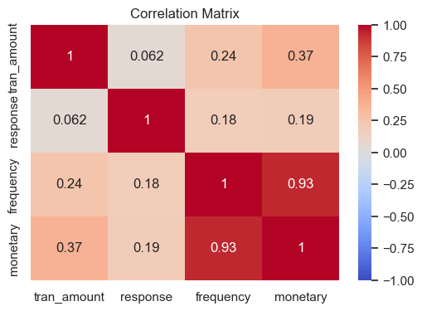
Correlation Analysis
Weak correlations between transaction amount, response, and frequency/monetary indicate no strong linear relationship with individual transactions or total spending.
Moderate correlation between transaction amount and monetary suggests a noticeable, but not strong, relationship between individual transaction amounts and total spending.
Strong correlation between frequency and monetary highlights that more transactions generally lead to higher total spending.

Slide 7
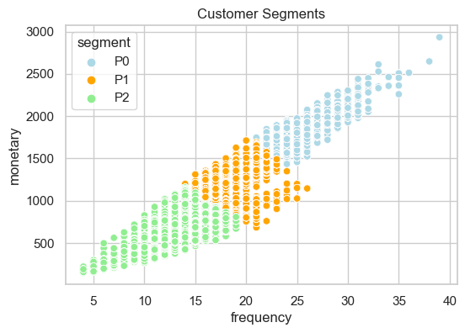
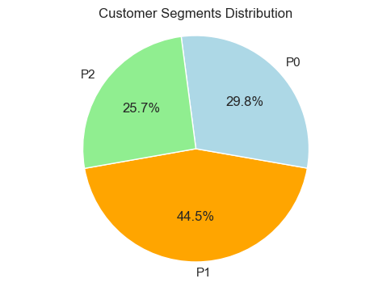
Customer Segmentation
Segmentation Process:
Standardization of features
Application of K-means clustering
Identification of customer segments (P0, P1, P2)
Insights:
Largest Segment (44.5%): Customers with medium purchase frequency and moderate spending(P1) forming the bulk of the customer base.
Second Largest Segment (29.8%): Frequent, high-spending shoppers(P0) who are highly valuable despite being fewer in number.
Smallest Segment (25.7%): Infrequent, low-spending shoppers(P2) offering potential for increased engagement and spending.
The largest customer segment makes regular, moderate purchases, while the most valuable segment consists of frequent high spenders. The smallest segment offers growth potential through increased engagement and spending.

Slide 8
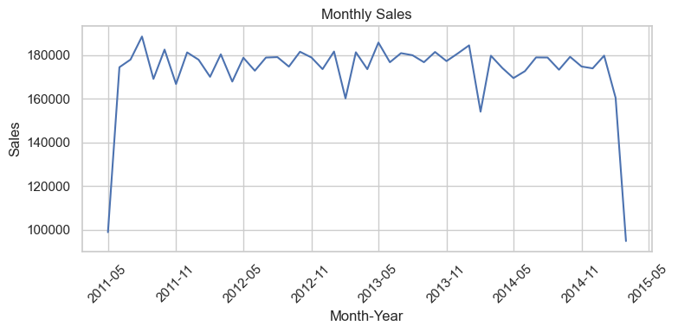
Time Series Analysis
Initial Growth and Stabilization: Rapid sales increase until mid-2011, then stable between 160,000 and 180,000 units/month.
Seasonal Fluctuations: Regular ups and downs suggest seasonal effects on sales.
Significant Anomalies: Sharp declines in late 2013 and March 2015 indicate possible external disruptions.
Sales trends show overall stability with a significant rise from March to May 2011 and periodic volatility. There’s no clear seasonal pattern, but outliers suggest external factors may influence sales.

Slide 9
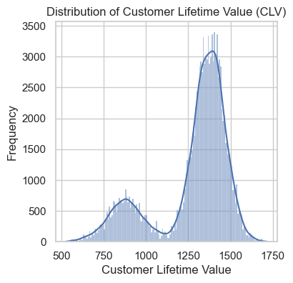
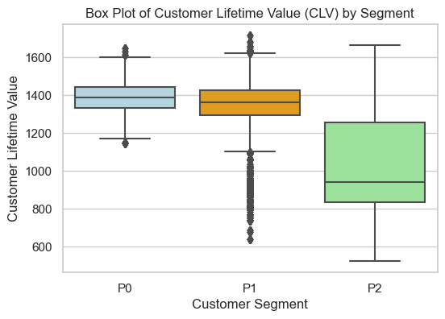
Customer Lifetime Value (CLV) Analysis
CLV Calculation :
Average Order Value= monetary/frequency.
Purchase frequency= mean of frequency.
CLV= Average Order Value * Purchase Frequency
CLV Distribution:
First Peak (around 1000): These customers likely have lower purchase frequency or lower average order value, indicating potential for growth.
Second Peak (around 1500): These customers have higher purchase frequency and higher average order value and are more valuable and contribute significantly to overall revenue.
Box Plot of CLV by Segment:
P0 : This segment represents the most valuable customers with consistently high CLV. Retention and growth strategies should focus on this segment to maintain their high value.
P1: Customers in this segment have a medium CLV, indicating room for improvement. Efforts could be made to increase purchase frequency or average order value to boost their overall CLV.
P2: This segment shows the most variability in CLV and generally has the lowest values. Targeted marketing and engagement strategies could help increase the value of customers in this segment, especially focusing on those with higher potential.
Focus retention and growth efforts on the high-value P0 segment, while targeting P1 and P2 with strategies to boost their purchase frequency and spending to enhance their overall CLV.

Slide 10
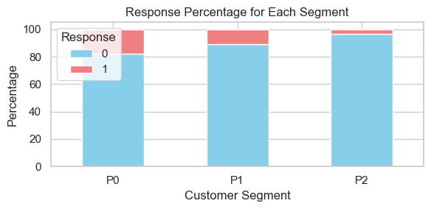
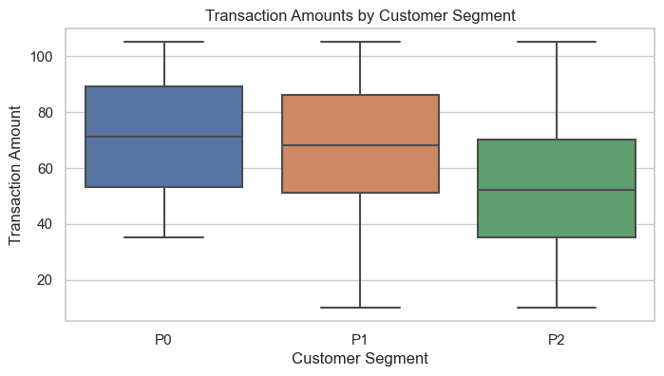
Hypothesis Testing
Chi-Square Test for Independence reveals: The chi-square test reveals a significant relationship between customer segment and response, rejecting the null hypothesis. The highest response rate is seen in the P0 segment (18%), indicating that high spenders are more likely to engage with the campaign compared to medium spenders (P1) and low spenders (P2).
ANOVA (Analysis of Variance) reveals: The ANOVA test indicates that there is a significant difference in mean transaction amounts across customer segments, rejecting the null hypothesis. Segment P0 has the highest average order value at $70.75, followed by P1 at $68.50, and P2 at $52.23, suggesting that high spenders (P0) have the highest transaction amounts.
High spenders (P0) not only show the highest transaction amounts but also have the highest response rate to the campaign, indicating they are both the most valuable and most engaged segment.

Slide 11
Detailed SQL Analysis Insights

Slide 12
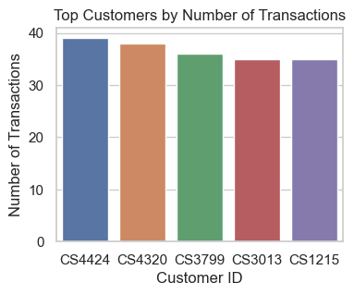
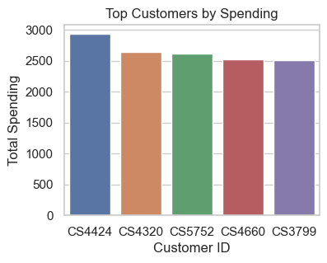
Key Customer Insights
Number of unique customers are 6,884.
Average transaction amount is 64.9951.
Average spend per customer is 1179.9.
Customers CS4424 and CS4320 have the highest number of orders and the highest spending, indicating strong engagement and consistent high-value purchases.
Customers CS5752 and CS4660, despite having less transactions, have high order values, leading to significant total spending.
This suggests varied purchasing patterns, with some customers making frequent smaller purchases and others making infrequent but large purchases.
The data reveals diverse purchasing patterns, with some customers making frequent smaller purchases and others making infrequent but large transactions, highlighting both high engagement and high-value spending.

Slide 13

Recency, Frequency, and Monetary (RFM) Segmentation
The customer segments are defined as follows:
Recency:
Recent: Customers with their last transaction within the past 200 days.
Medium: Customers whose last transaction occurred between 201 and 400 days ago.
Old: Customers whose last transaction was over 400 days ago.
Frequency:
Frequent: Customers with 25 or more transactions.
Medium: Customers with 10 to 24 transactions.
Infrequent: Customers with fewer than 10 transactions.
Monetary:
High Value: Customers with total spending of 2000 or more.
Medium: Customers whose total spending ranges from 1000 to 1999.
Low Value: Customers with total spending less than 1000.

Slide 14
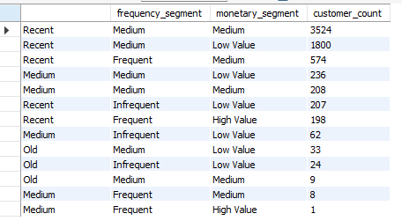
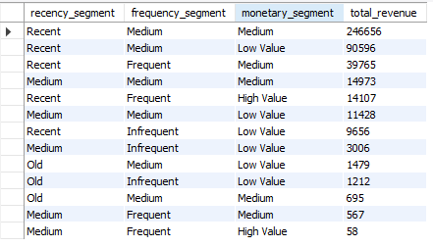
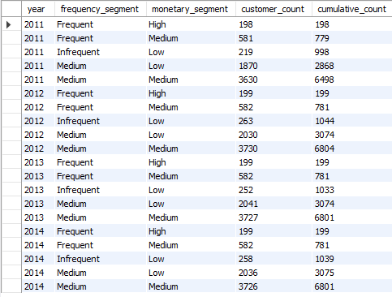

Recency, Frequency, and Monetary (RFM) Analysis
The "Recent-Medium-Medium Value" segment is the largest, with many customers having moderate spending and recent transactions.
Excluding 2015, the "Medium-Medium" and "Medium-Low Value" segments grew from 2011 to 2013 and stabilized in 2014.
Recent customers have the highest response rate at 9.55%, followed by Medium customers at 8.54%, and Old customers at 1.52%.
The "Recent-Medium-Medium" segment generates the highest revenue ($246,656). Medium and Old segments contribute less, with the highest among them being "Medium-Medium-Medium Value" at $14,973.
Focus on recent and medium-frequency customers, especially the "Recent-Medium-Medium" segment, to maximize engagement and revenue.

Slide 15
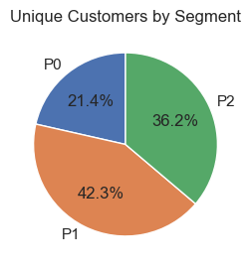
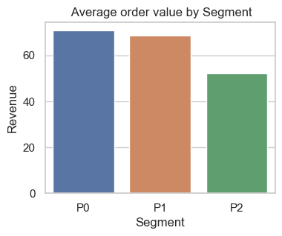
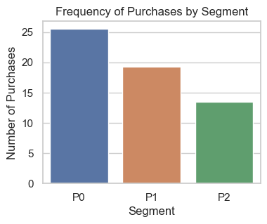
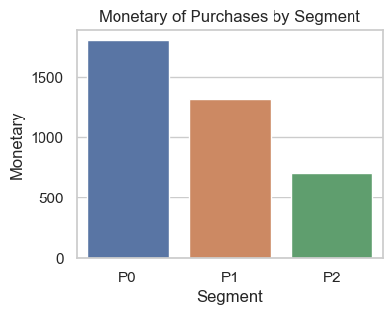
Behavior and Performance by Segment
Segment P1 has the largest unique customer base (2915), followed by P2 (2493) and P0 (1476).
P0 has the highest average order value(70.75), followed by P1 (68.5) and P2 (52.23).
P0 has the highest average purchase frequency (25.5), followed by P1 (19.3) and P2 (13.46).
P0 has the highest average monetary value (1802.6), compared to P1 (1316.6) and P2 (703.8).
P0 has the most consistent average order value over time, with the lowest standard deviation (4.03), while P2 has the highest variation (12.72).
Segment P0 is the strongest performer overall, with the highest and most consistent transaction metrics across all categories.

Slide 16
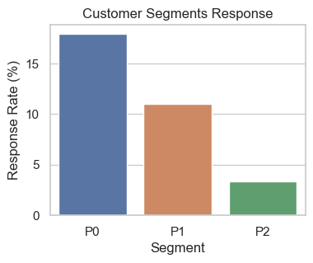
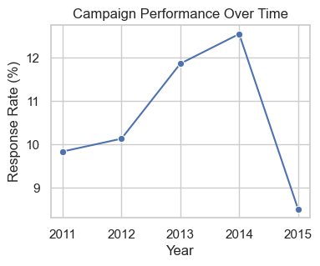
Campaign Performance
Only 11% of customers responded positively to the campaign overall.
The P0 segment had the highest response rate (18%), compared to P1 (11%) and P2 (3.3%), indicating better resonance with high spenders.
Campaign performance improved significantly from 2011 to 2014, with response rates consistently above 10% during these years.
The campaign is most effective with high spenders (P0), and improved performance from 2011 to 2014 shows positive impact.

Slide 17
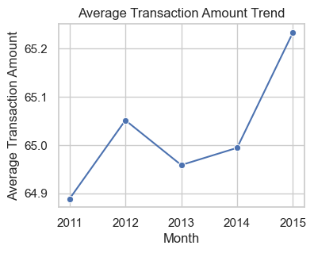
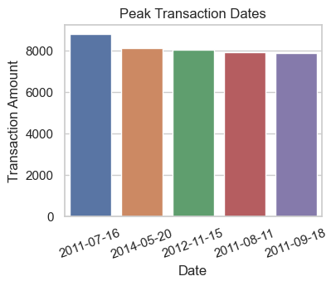
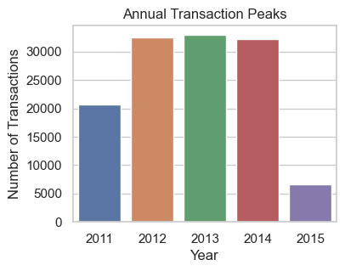
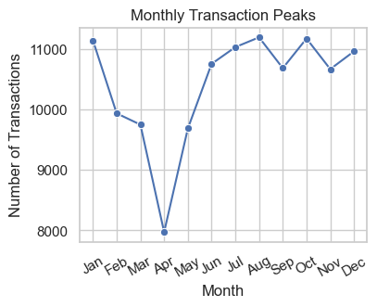
Trends And Seasonality
Peak amounts were on July 16, 2011 (8,791), May 20, 2014 (8,108), November 15, 2012 (8,054), August 11, 2011 (7,938), and September 18, 2011 (7,866).
Highest in 2013 (32,900 transactions), followed by 2012 and 2014. While lowest was in April( 7973 transactions).
August led with 11,195 transactions, followed by October (11,175) and July (11,033). But there’s a steep dip in the month of April with only 7973 transactions.
Consistent around $65 from 2011 to 2015.
High transactions were recorded on specific dates and in 2013, with notable peaks in August, October, and July, indicating effective promotions or seasonal trends. Despite these variations, average spending remained consistently stable at 65.

Slide 18
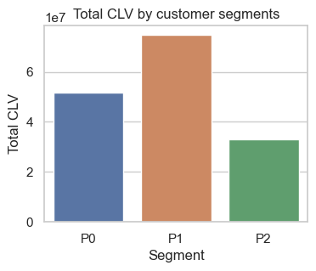
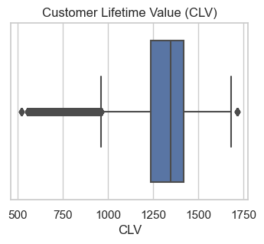
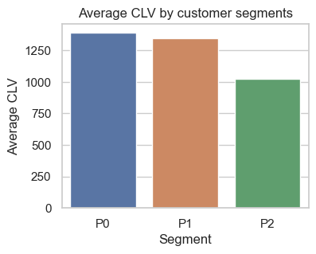
Customer Lifetime Value(CLV) Insights
The maximum customer lifetime value (CLV) is 1,716, while the minimum is 524.23.
Segment P1 has the highest total CLV at 74,771,322.94, followed by P0 at 51,770,937.67, and P2 at 32,932,226.57.
Segment P0 leads with the highest average CLV of 1,389, followed by P1 at 1,345.27 and P2 at 1,025.42. This suggests P0 customers are highly valuable individually, while P1 has a strong overall contribution to revenue, and P2 presents growth opportunities.
Segment P1 contributes most to total revenue, while Segment P0 has the highest individual customer value. Segment P2 shows potential for growth through targeted strategies.

Slide 19


Consecutive Transaction Analysis
6,884 customers have made consecutive transactions.
Segment P1 has the most customers with consecutive transactions (2,913), followed by P2 (2,341) and P0 (1,476).
The overall average time between consecutive transaction is 72.37 days.
Segment P0 has the shortest average time between consecutive transactions (53 days), followed by P1 (70 days) and P2 (100 days).
Segment P1 has the highest number of customers with consecutive transactions, while Segment P0 has the shortest average time between these transactions. Overall, customers in P0 engage more frequently, while P1 shows broad engagement across a larger customer base.

Slide 20
SWOT Analysis
Strengths:
High-value customers (P0) show strong engagement and high transaction amounts.
Segment P0 has the shortest average time between consecutive transactions(53 days).
Stable average spending of around $65.
Low overall campaign response rate of 11%.
Segment P2 has low engagement and value, with longest average time between consecutive transactions(100 days).
Opportunities:
Target Segment P2 with personalized marketing to boost engagement.
Continue leveraging high-value Segment P0 and “Recent-Medium-Medium Value” customers with loyalty programs.
Threats:
Vulnerability to external disruptions, as seen in sales drops in early 2013 and 2015.
Market saturation limits growth potential without innovative strategies.
Recent and medium-frequency segments contribute significantly to revenue and show higher engagement.
Variability in CLV among segments suggests inconsistent customer value.
Weaknesses:
Segment P2’s infrequent engagement poses a risk if not addressed, potentially impacting overall revenue growth.
April has the lowest transaction count(7973), suggesting a potential seasonal dip.
Promote strategies to encourage more frequent transaction among lower-value segments.
Develop strategies to counteract low transaction counts in April.

Slide 21
Recommendations
Enhanced Targeting for Low Spend Segments: Develop and implement targeted campaigns to increase engagement and spending in Segment P2 and other lower-value groups.
Maximize High-Value Customer Potential: Focus on retaining and growing Segment P0 through loyalty programs and personalized offers to maintain high engagement and revenue.
Utilize RFM Insights: Prioritize strategies that cater to "Recent-Medium-Medium Value" and "Frequent-High" segments to optimize revenue and engagement.
Adapt to Sales Fluctuations: Monitor and adapt strategies to address seasonal and external factors impacting sales trends and campaign performance.
Increase Response Rates: Revise campaign strategies to better resonate with a broader customer base and improve overall response rates.
Encourage More Frequent Transactions: Implement promotions and incentives to shorten the time between consecutive transactions for all segments, particularly targeting Segment P2.
Optimize Pricing Strategies: Review and adjust pricing strategies to better match customer segments' spending power and preferences, particularly for high-value and infrequent buyers.
Adapt to Sales Fluctuations: Monitor and adapt strategies to address seasonal and external factors impacting sales trends and campaign performance, especially focusing on mitigating declines like those observed in April.

Slide 22
Summary of Key Insights
Customer Segmentation: Segment P0 is the most valuable with high transaction amounts and response rates. Segment P1 has broad engagement, while P2 shows potential for growth. The "Recent-Medium-Medium Value" segment is the largest and most revenue-generating, with recent customers having the highest response rates.
Campaign Performance: The campaign is most effective with high spenders (P0) and has improved over time, although overall response rates remain low.
Sales Trends: Sales are stable with occasional peaks and troughs. High transactions were recorded in specific periods and seasons, with a notable decline in April (7,973 transactions) indicating potential seasonal or external impacts.
RFM Analysis: Recent and medium-frequency segments are highly valuable, particularly the "Recent-Medium-Medium Value" group, which generates significant revenue. Segment P0 shows the highest individual CLV, while Segment P1 contributes most to total revenue, and Segment P2 presents growth opportunities.
Consecutive Transactions: Segment P0 has the shortest average time between transactions, indicating strong loyalty, while Segment P1 shows high engagement across a larger customer base, and Segment P2 has less frequent engagement.

Slide 23
Future Steps
Implement Targeted Marketing: Focus on strategies to enhance engagement and spending in low-value segments, using insights from RFM analysis.
Optimize Customer Retention: Develop programs to retain high-value customers and increase their lifetime value, particularly focusing on P0 and "Recent-Medium-Medium Value" customers.
Monitor and Adapt Strategies: Continuously track sales trends and campaign performance, adapting strategies to address external factors and seasonal fluctuations.
Enhance Engagement Efforts: Promote initiatives to reduce the average time between transactions across all segments, particularly targeting those with less frequent purchases.
Revise Campaign Strategies: Adjust and personalize campaigns to better engage a broader customer base and improve overall response rates.

Slide 24

Thank you!
Connect via:
Email: rupsachaudhuri9@gmail.com
LinkedIn
GitHub

